Slide 1


Presented By : The Assembly Team
SSID:- In5- Tech
Pass:- WelcomeToIn5

Slide 2
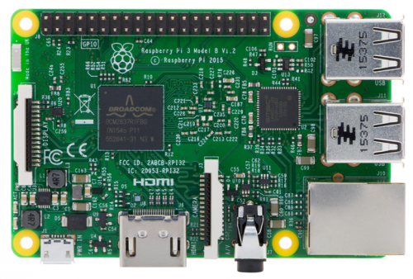
Raspberry Pi

Slide 3
How is it Different?
A 1.2GHz 64-bit quad-core ARMv8 CPU
802.11n Wireless LAN
Bluetooth 4.1
4 USB ports
40 GPIO pins
Full HDMI port

Slide 4
Competitors
https://screenshots.firefox.com/viOBpeRac0nudyW4/nextthing.cohttps://screenshots.firefox.com/viOBpeRac0nudyW4/nextthing.co
Notes:
*The HC-06 acts as a serial port through which you can send and receive data.
*So using a serial terminal or a Bluetooth customized application on your computer or phone, you can control and monitor your project.
*HC06 functions only as slave to a microcontroller

Slide 5
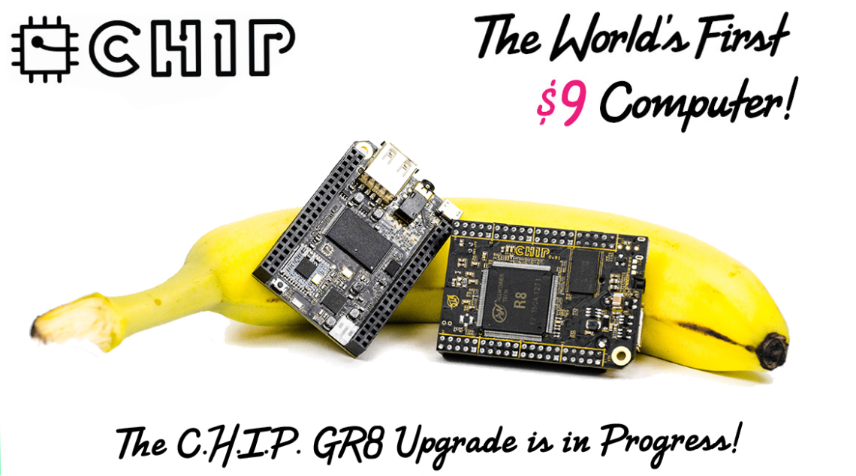
https://screenshots.firefox.com/viOBpeRac0nudyW4/nextthing.cohttps://screenshots.firefox.com/viOBpeRac0nudyW4/nextthing.co

Slide 6
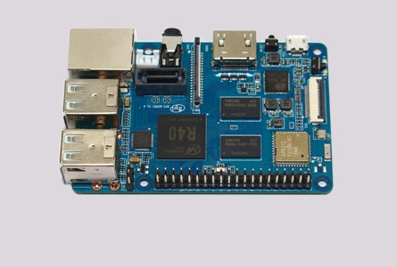
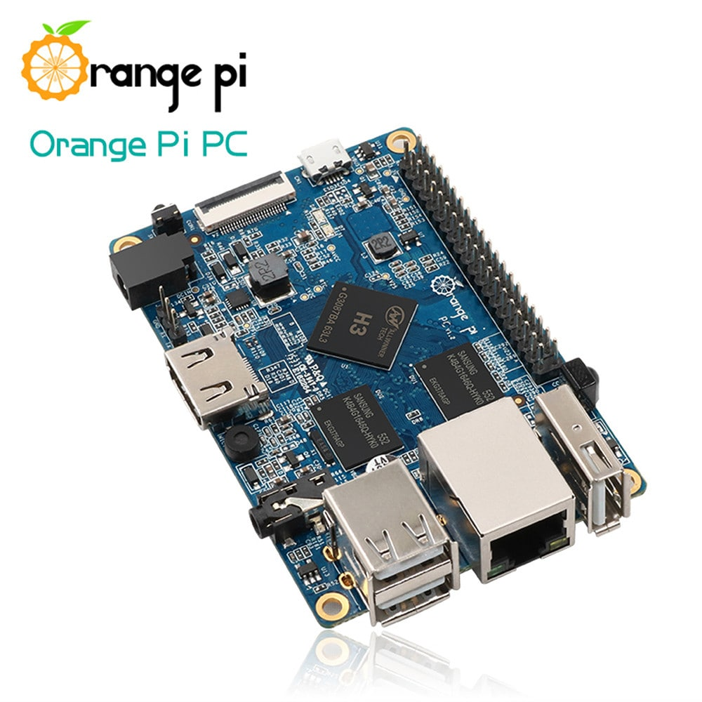
https://screenshots.firefox.com/viOBpeRac0nudyW4/nextthing.cohttps://screenshots.firefox.com/viOBpeRac0nudyW4/nextthing.co
Banana Pi
Orange Pi

Slide 7
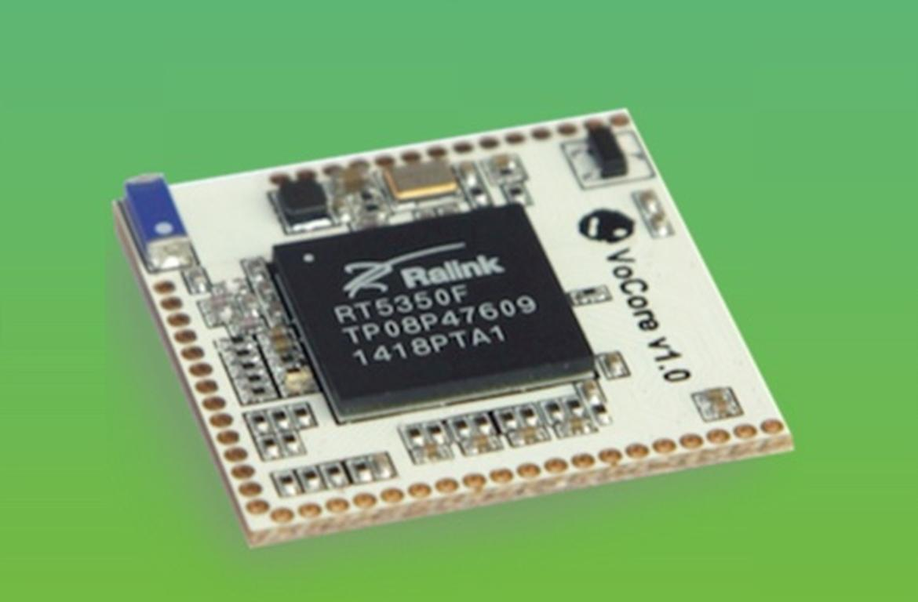
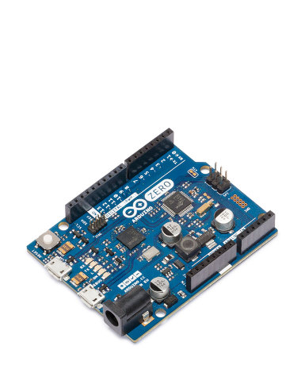
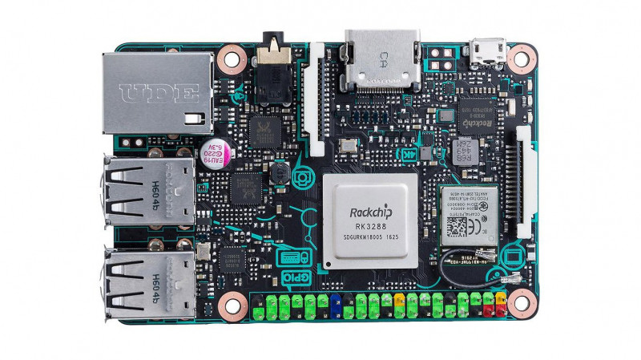
VoCore
Arduino Uno
Asus Tinkerboard

Slide 8
Objective for Today
Learn about Raspberry Pi Basics
Learn about the hardware
Boot Raspbian OS
Getting familiar with the OS
Code to control
LED
Servo
LCD
Ultrasonic

Slide 9
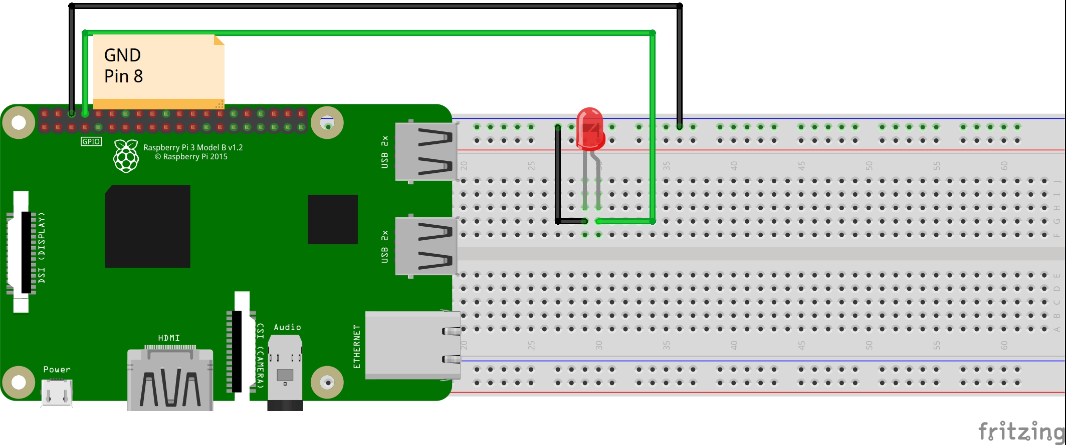
Connecting LED

Slide 10
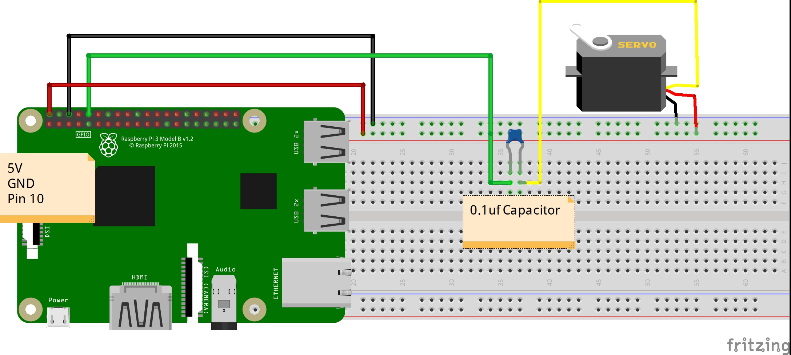
Connecting Servo

Slide 11
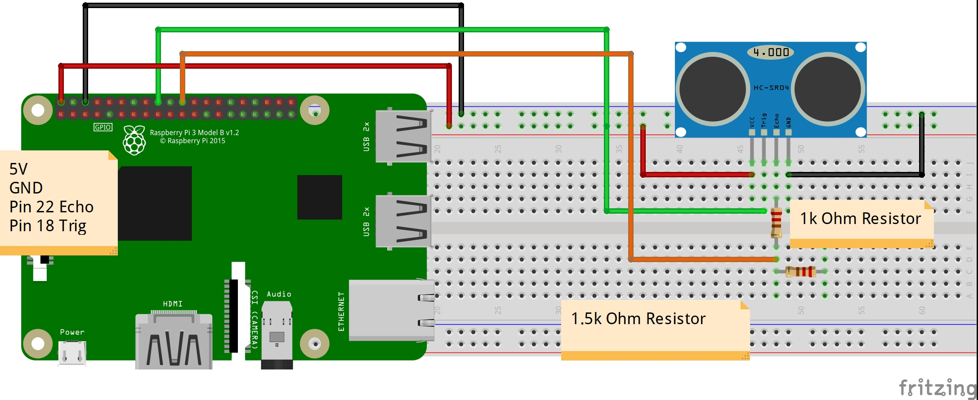
Connecting Ultrasonic

Slide 12
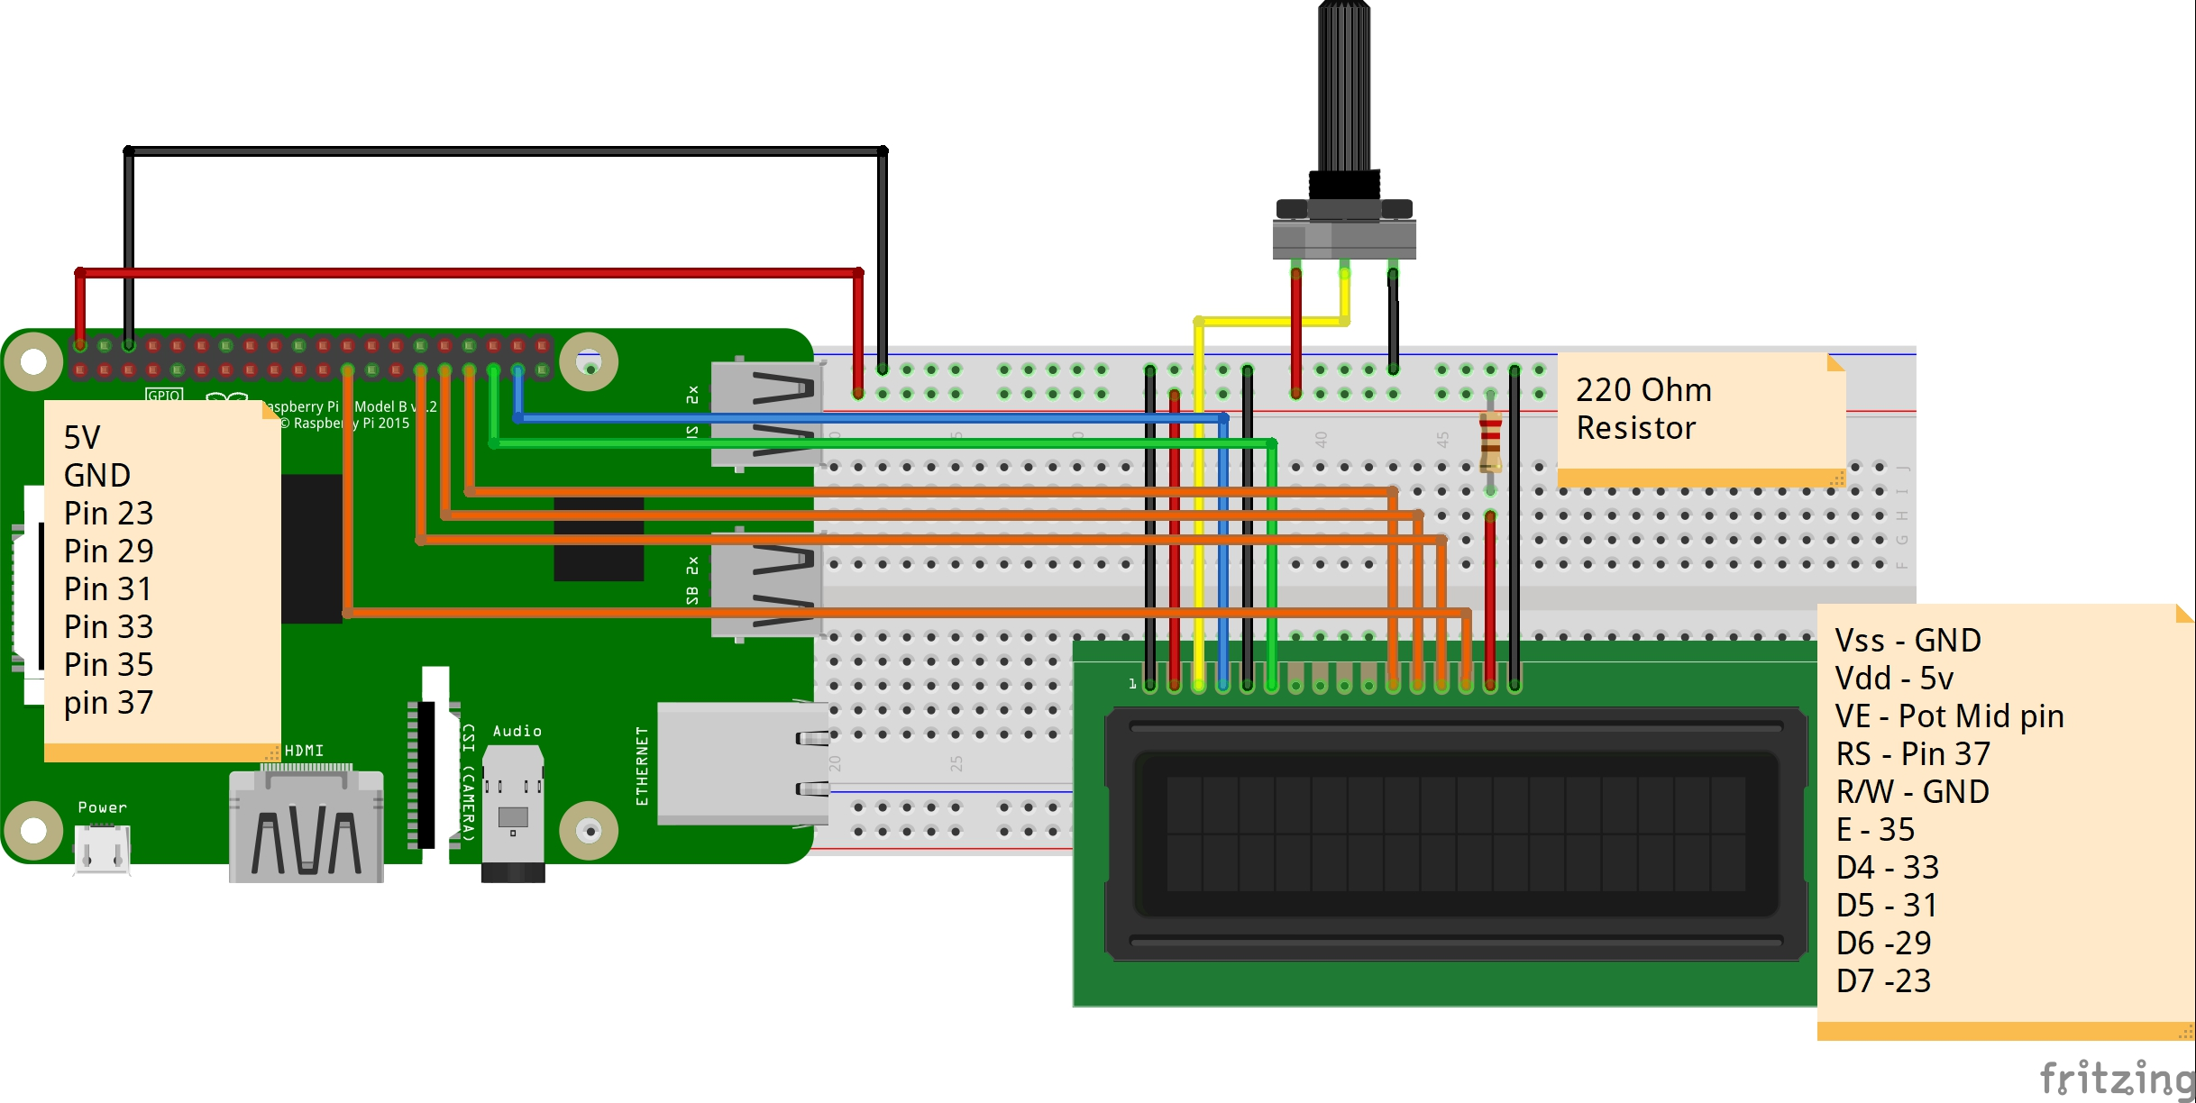
Connecting LCD

Slide 13

THANK YOU

